Slide 1




Funded by:
Partnered with:

Slide 2
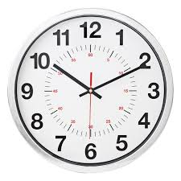
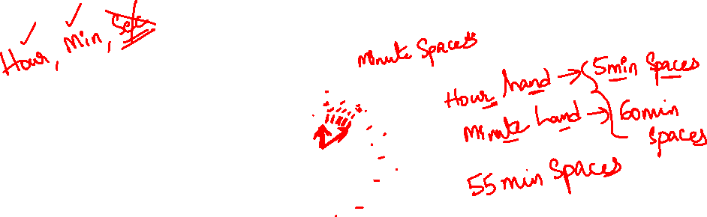
CLOCKS

Slide 3
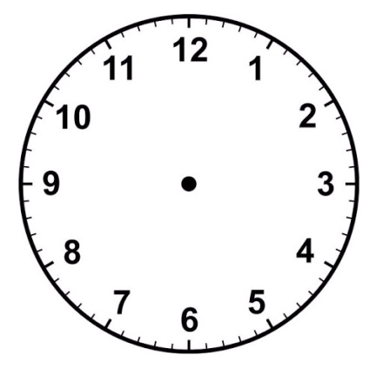


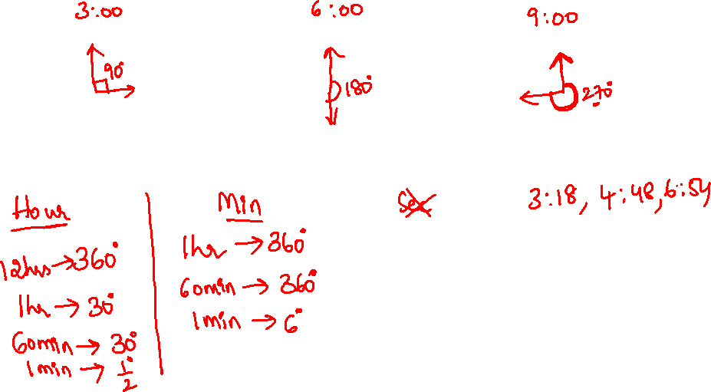

Slide 4

INTRODUCTION TO CLOCKS
HOUR MINUTE
12hrs 360° 1hr 360°
1hr 30° 60min 360°
60min 30° 1min 6°
1min 1/2°

Slide 5

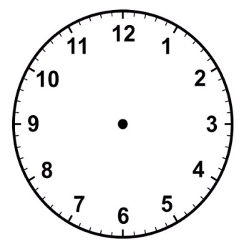
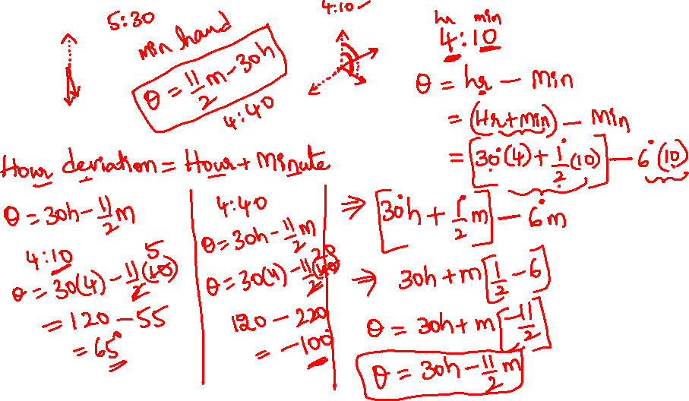

Slide 6

POINTS TO REMEMBER
Hour hand deviation = hour hand + minute hand
Angle between hands of clock θ=30H-11/2M
Reflex angle = 360-θ
55minute spaces are gained by minute hand in 60min (55min=60)

Slide 7
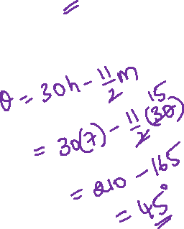
What is the angle made by hands of the clock when the time is 7:30
a) 50° b) 65° c)40° d) 45°

Slide 8
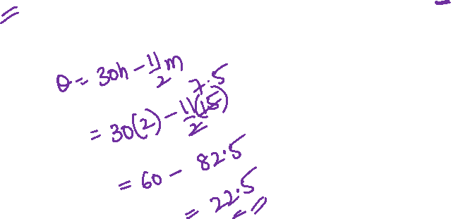
What is the angle made by hands of the clock when the time is 2:15
a) 25° b) 22.5° c)24.5° d) 30°

Slide 9
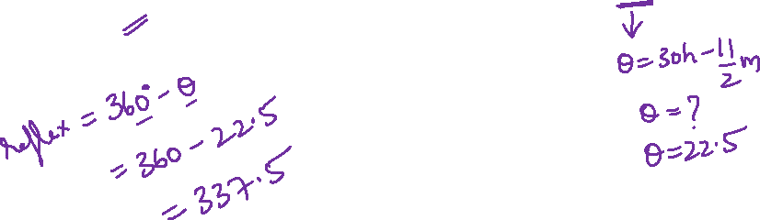
What is the reflex angle made by hands of the clock when the time is 2:15
a) 325° b) 322.5° c)337.5° d) 335°

Slide 10
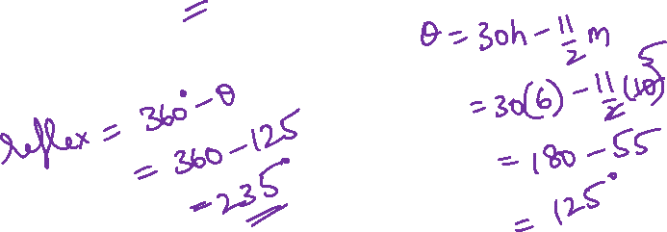
What is the reflex angle made by hands of the clock when the time is 6:10
a) 225° b) 222.5° c)233.5° d) 235°

Slide 11
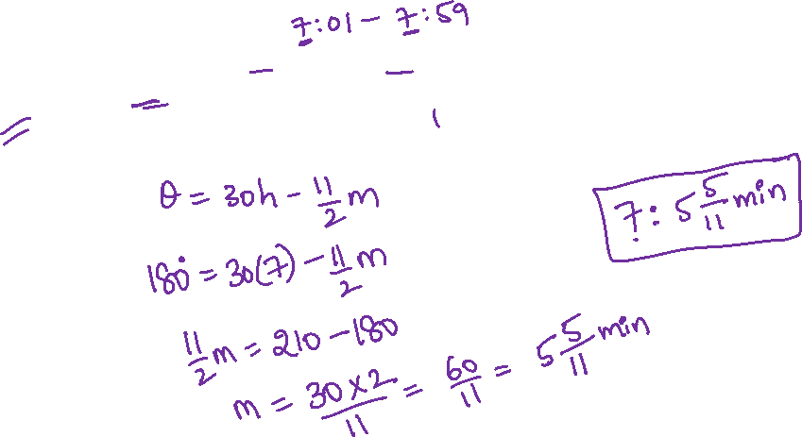
At what time between 7’o clock and 8’o clock the angle made by hands of the clock is 180°
a) 7:5 5/11min b) 7:10 2/11min c) 7:10 10/11min d)7:8 10/11min

Slide 12
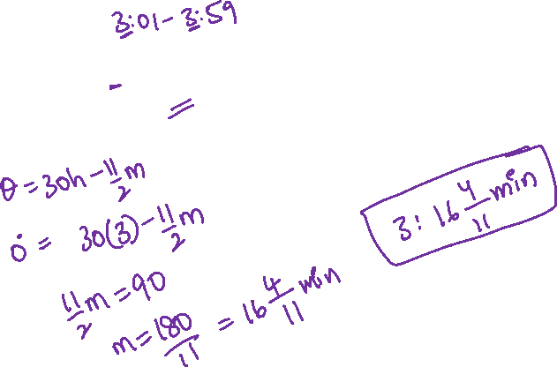
At what time between 3’o clock and 4’o clock the angle made by hands of the clock are together(0°)
a)3:6 4/11min b)3:6 5/11min c) 3:16 4/11min d) 3: 16 5/11min

Slide 13
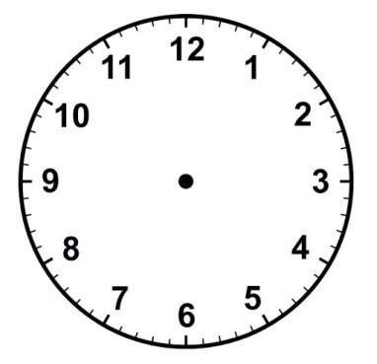
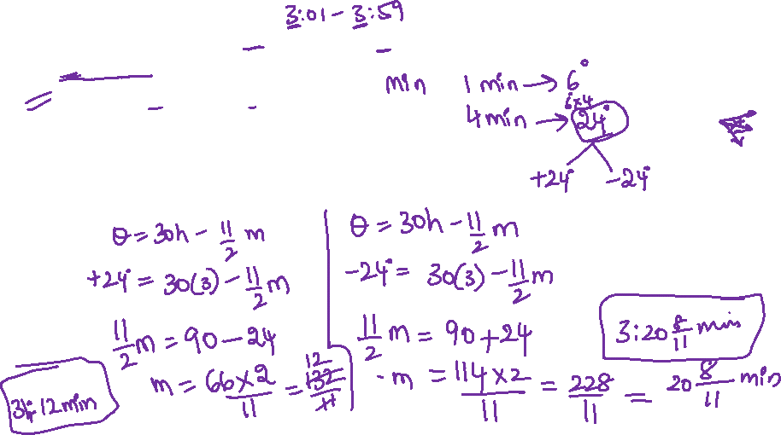
At what time between 3’o clock and 4’o clock will both hands of the clock be 4 minutes apart?
3hr:12min , 3hr: 20 8/11min
3hr:18min , 3hr: 22 9/11min
3hr:15min , 3hr: 15 5/11min
3hr: 20min, 3hr: 20 3/11 min

Slide 14
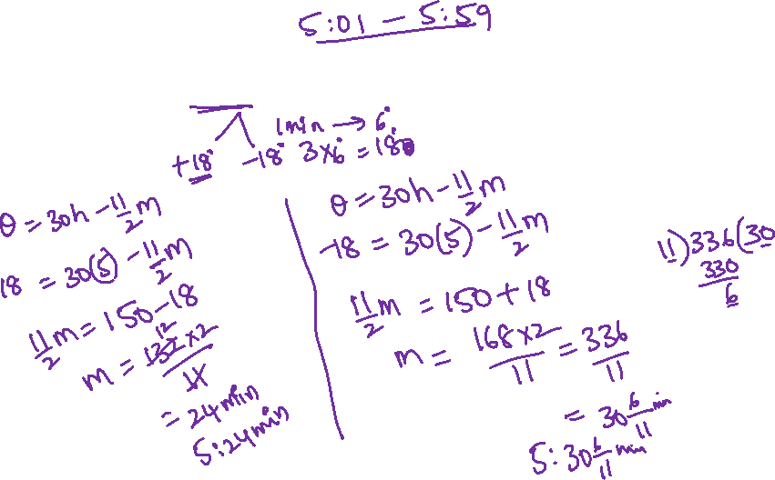
At what time between 5’o clock and 6’o clock will both hands of the clock be 3 minutes apart?

Slide 15
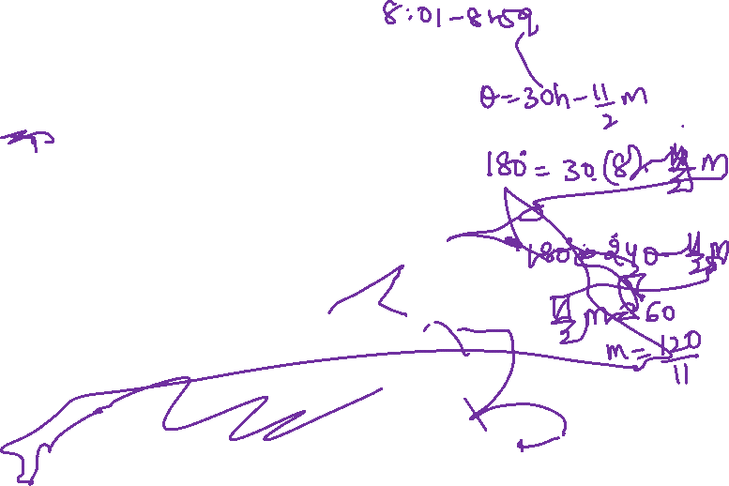
At what time between 8'o clock and 9'o clock the angle made by hands of the clock is 180 degrees
a) 8: 10 10/11 min
b) 8: 10 8/11 min
c) 8: 9 10/11min
d) 8: 6 7/11min

Slide 16
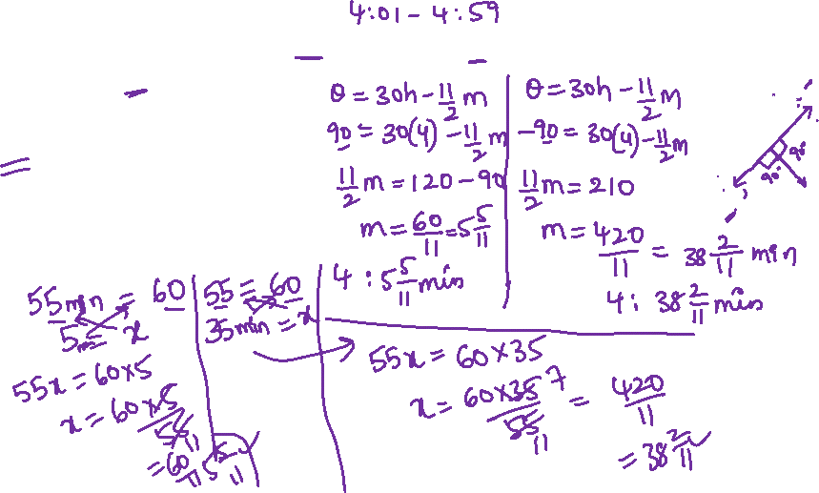
At what time between 4’o clock and 5’o clock will both hands of clock be at right angle?
4:6 min, 4: 38 min
4:5 min, 4:38 min
4:7 min, 4: 38 min
4:2 min, 4: 38 min

Slide 17
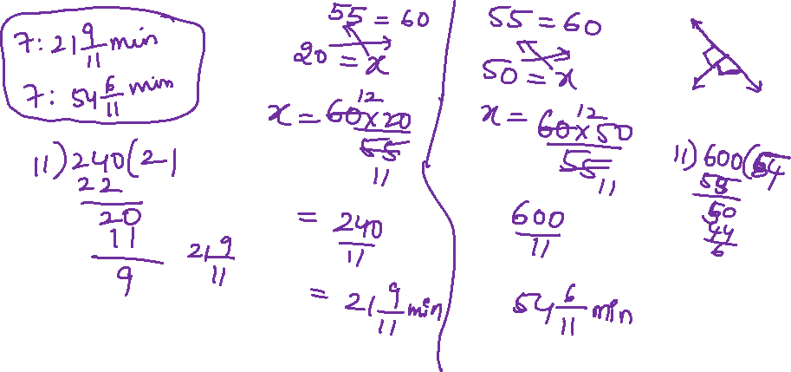
At what time between 7’o clock and 8’o clock will both hands of clock be at right angle?

Slide 18
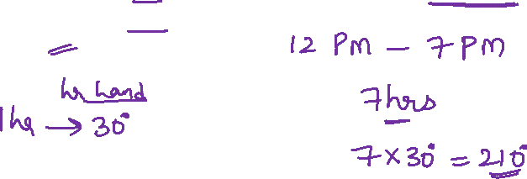
An accurate clock shows 12pm. By how many degrees an hour hand rotate when the clock shows 7pm?
a) 200° b) 205° c) 210° d) 220°

Slide 19
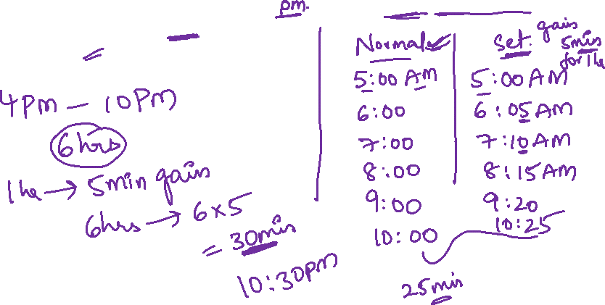
Harish saw a clock when it was set right at 4m. The clock gains 5min every hour.What time will it show at 10pm same day?
a) 11pm b)10pm c)10:30pm d)11:30pm

Slide 20
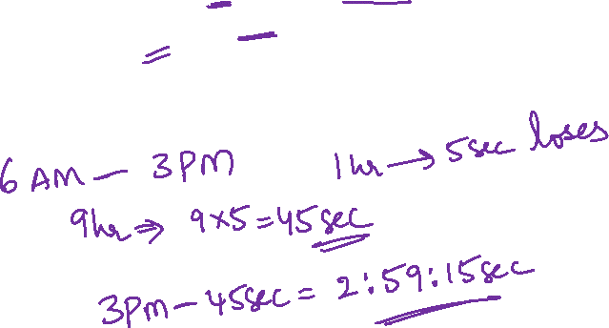
Prince observed that a watch loses 5seconds in one hour which was set right at 6am. What time will it show at 3pm on same day?
a)2hr:57min:25sec b)2hr:59min:15sec
c)2hr:58min:25sec d)2hr:59min:25sec

Slide 21
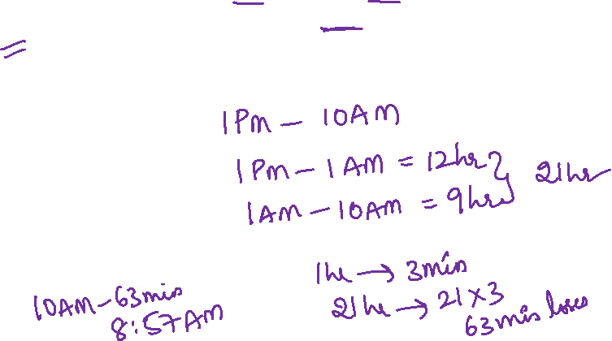
A clock is set correctly at 1pm. If it loses 3min every hour, what time will clock show when the correct time is 10am the next day?
a)8:57am b)8:55am c)8:45am d)8:59am

Slide 22
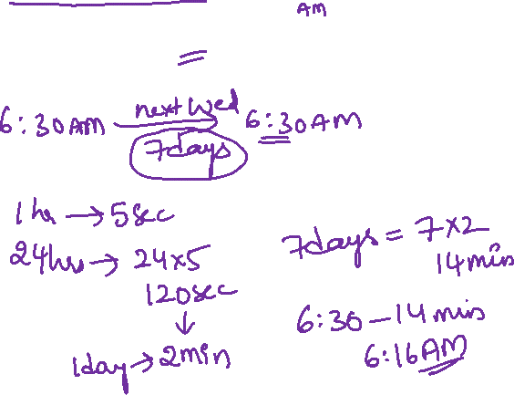
A watch losses 5seconds every hour. The watch was set correctly on Wednesday at 6:30 am. what time did it show at 6:30 on next Wednesday?
a)6:15am b)6:20am c)6:16am d)6:18am

Slide 23
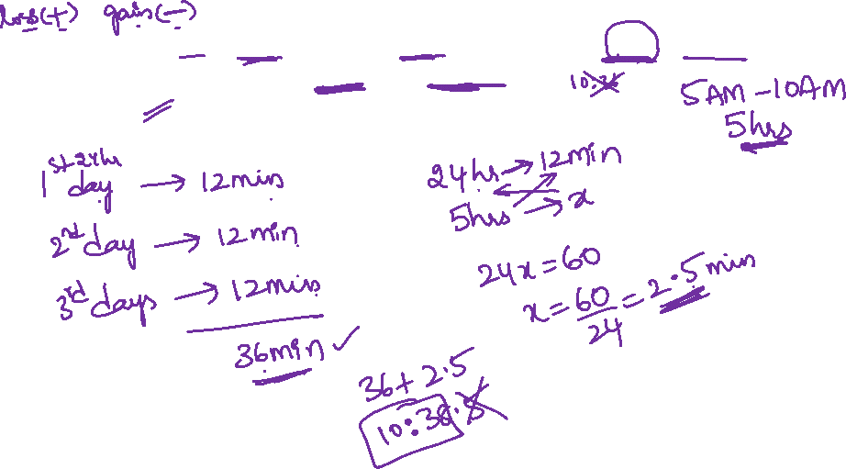
A clock which losses 12min for every 24hrs was set right at 5am. After 3rd day when the clock indicates 10am. The true time is?
a)10:30am b)10:38am c)10:40am d)10:45am

Slide 24
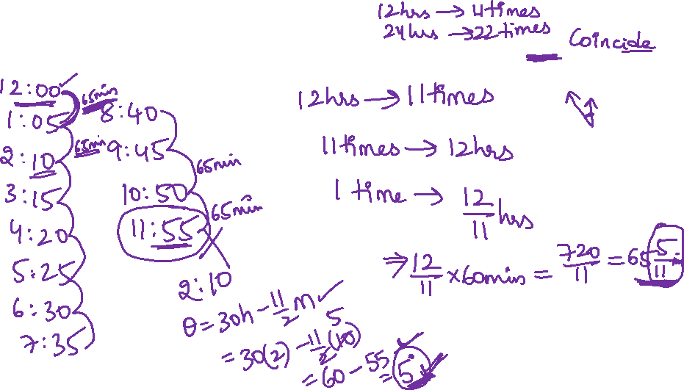
How many times in a day the angle made by hands of the clock is 0°

Slide 25

Note :
For every 65 5/11 minutes hands of the clock will coincide

Slide 26
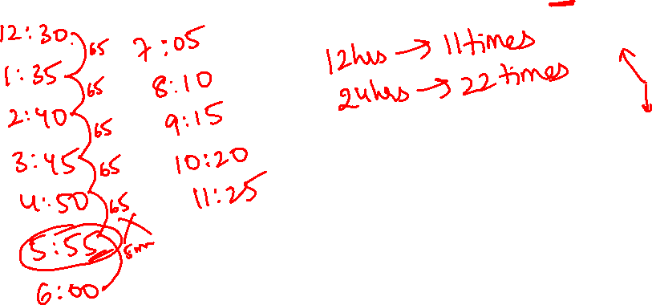
How many times in a day angle made by hands of the clock is 180°

Slide 27
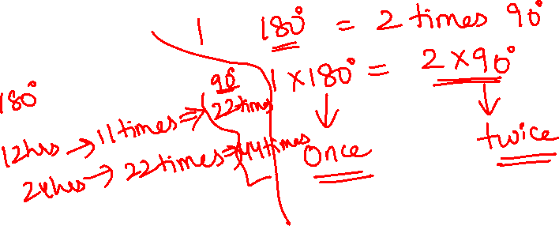
How many times in a day angle made by hands of the clock is 90°
(perpendicular)

Slide 28
0° 180°
12hrs - 11times 12hrs - 11times
24hrs - 22 times 24hrs - 22times
90°
12hrs - 22times
24hrs - 44times

Slide 29
Thank You
Best ahead!!

